Slide 1
The Value of Deception in Resilient Basing
MAJ Olin Kennedy, USA
2 Lt. Elisha Palm, USAF
Dr. Mark Gallagher, USAF
LTC Timothy Holzmann, USAF

Slide 2
Overall Problem and Research Gap
Problem
Research Gap
Proliferation of Long-Range Precision Munitions (LRPM) affects the security of airbases, traditionally thought of as secure from attack.
Responses to this threat:
Resilient Basing (RB), or How do I build a base that can withstand a missile attack?
Agile Combat Employment (ACE), or How can I operate aircraft away from main bases in a way that enhances survivability but preserves sortie generation?
RAND has done some very thorough studies and modeling into Resilient Basing and Agile Combat Employment
Deception and Decoys are often mentioned as critical but all examples found were historical/anecdotal. We found no supporting analysis or modeling of this claim.

Slide 3
Research Questions
Should decoys and deception be part of a future solution to the LRPM Threat?
How can you capture/measure the value of Deception?
Is Deception Cost-Effective?

Slide 4
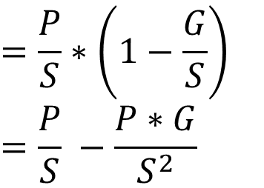

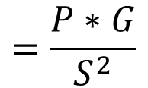
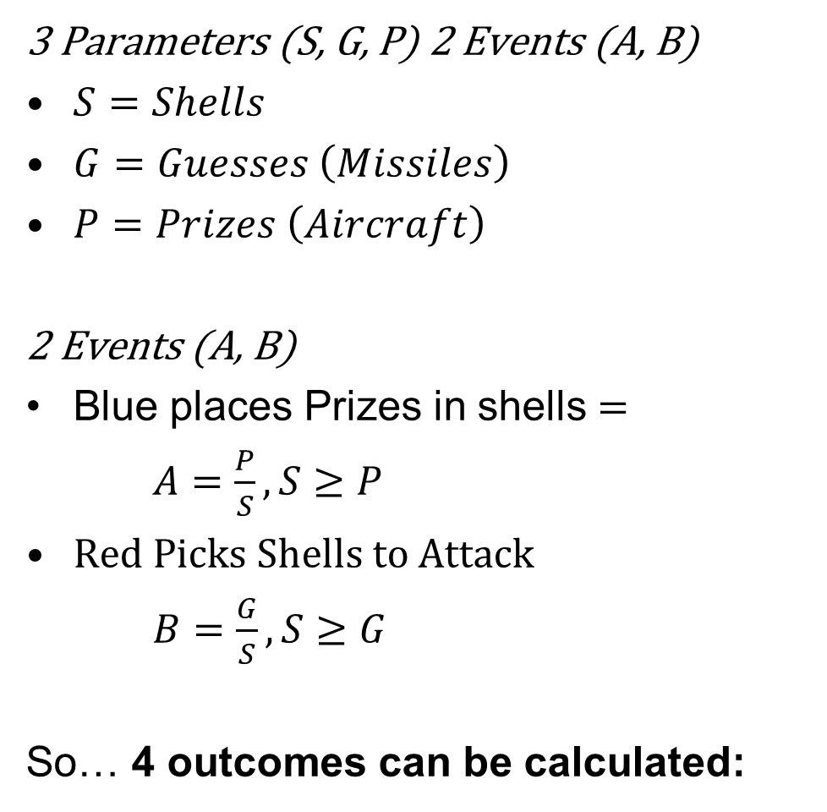


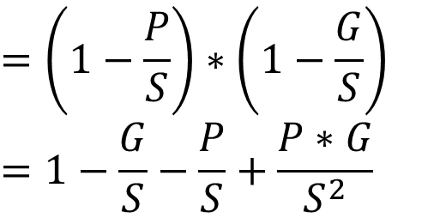

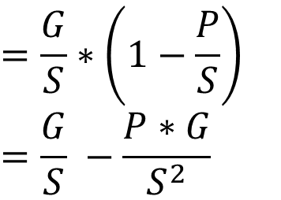
Shell Game Model
3 Parameters (S, G, P) 2 Events (A, B)
$S=Shells$
$G=Guesses \left(Missiles\right)$
$P=Prizes \left(Aircraft\right)$
2 Events (A, B)
Blue places Prizes in shells $=$
$A=\frac{P}{S}, S≥P$
Red Picks Shells to Attack
$B=\frac{G}{S},S≥G$
So… 4 outcomes can be calculated:
P(A/C, Missile)
P(No A/C, No Missile)
$$=A∗B$$
$$=(1−A)∗(1−B)$$
$$=\frac{P∗G}{S^{2}}$$
$$=\left(1−\frac{P}{S}\right)∗\left(1−\frac{G}{S}\right)$$
$$=1−\frac{G}{S}−\frac{P}{S}+\frac{P∗G}{S^{2}}$$
P(A/C, No Missile)
P(No A/C, Missile)
$$=A∗(1−B)$$
$$=(1−A)∗(B)$$
$$=\frac{P}{S}∗\left(1−\frac{G}{S}\right)$$
$$=\frac{P}{S} −\frac{P∗G}{S^{2}}$$
$$=\frac{G}{S}∗\left(1−\frac{P}{S}\right)$$
$$=\frac{G}{S} −\frac{P∗G}{S^{2}}$$

Slide 5
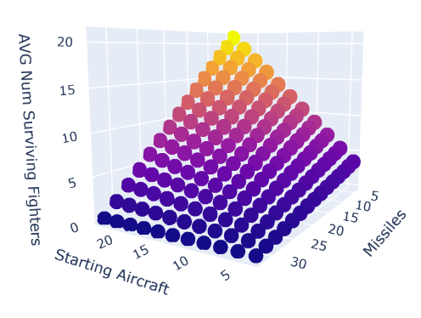
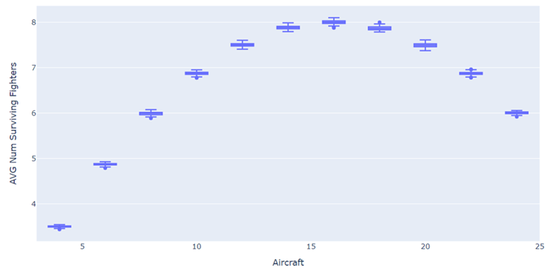
Shell Game Model Results
What Happens if we vary P,G?
What if P=G?
To break out of the linearity, assume Guesses = Prizes
16 A/C
S = 32 P, G = Varied
S = 32 P = Varied, G=P
Linear Responses on Surviving Fighters by varying P, G as expected
Then, you can maximize surviving fighters with a 1:2 Aircraft/Shell Ratio p=0.5 Binomial

Slide 6
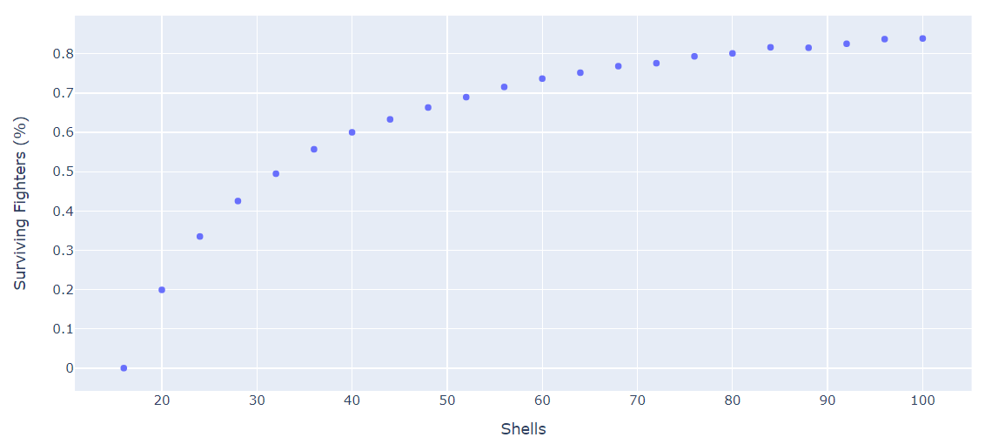
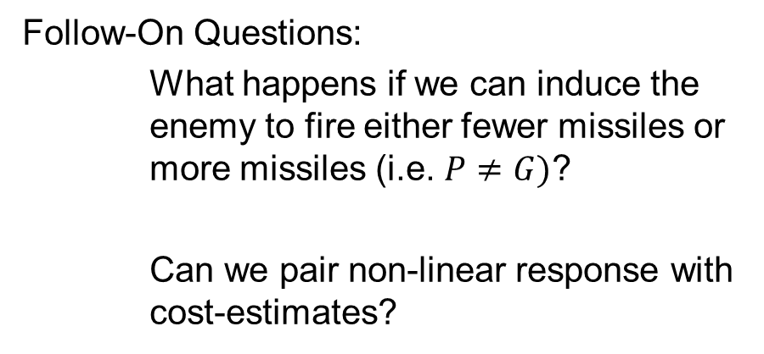
Shell Game Model Results
What if we vary S?
Take-aways:
Linear Relationship to Outcomes by Varying number of Aircraft at a Base or Enemy varying the size of the missile barrage
Non-Linear relationship to adding additional shells and playing shell game.
First analytical evidence of value of deception
Follow-On Questions:
What happens if we can induce the enemy to fire either fewer missiles or more missiles (i.e. $P≠G)$?
Can we pair non-linear response with cost-estimates?
S = Varied P = G = 16
Non-Linear Response to Surviving Fighters to increasing S large changes at the small end of the spectrum

Slide 7
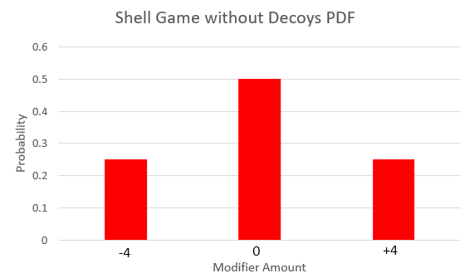
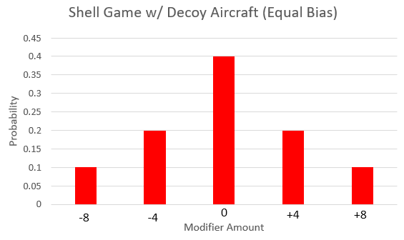
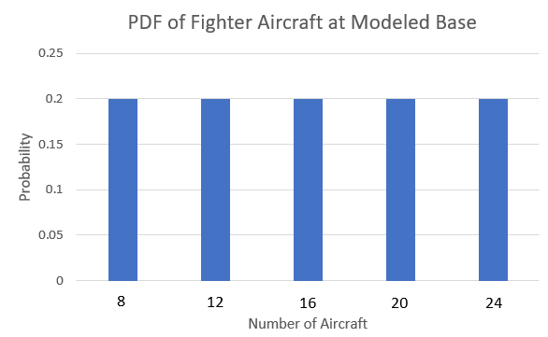
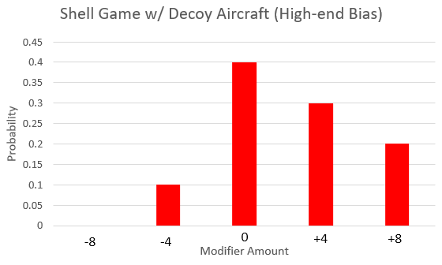
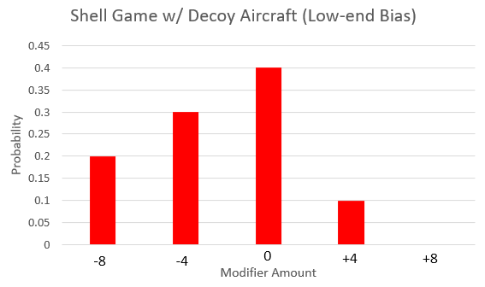
Inducing Enemy Error in Shell Game Model
S=32 P = Varied
Blue varies number of aircraft at the airbase at any given time

Slide 8
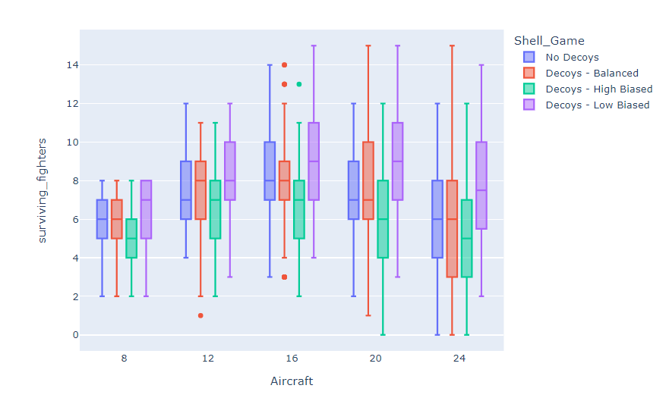
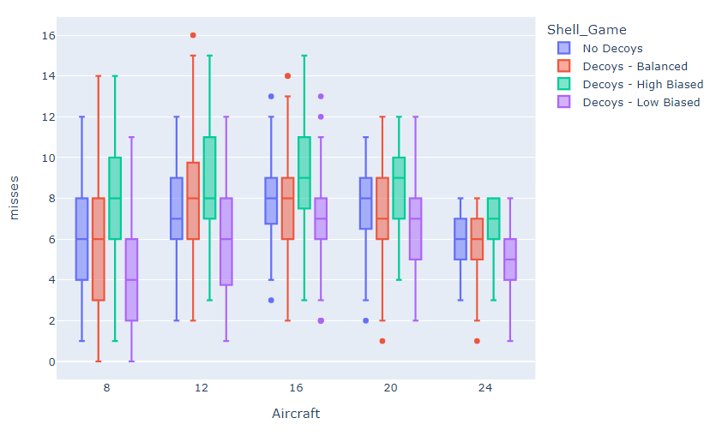
Cost/Value of Decoys vs. Shells

Slide 9
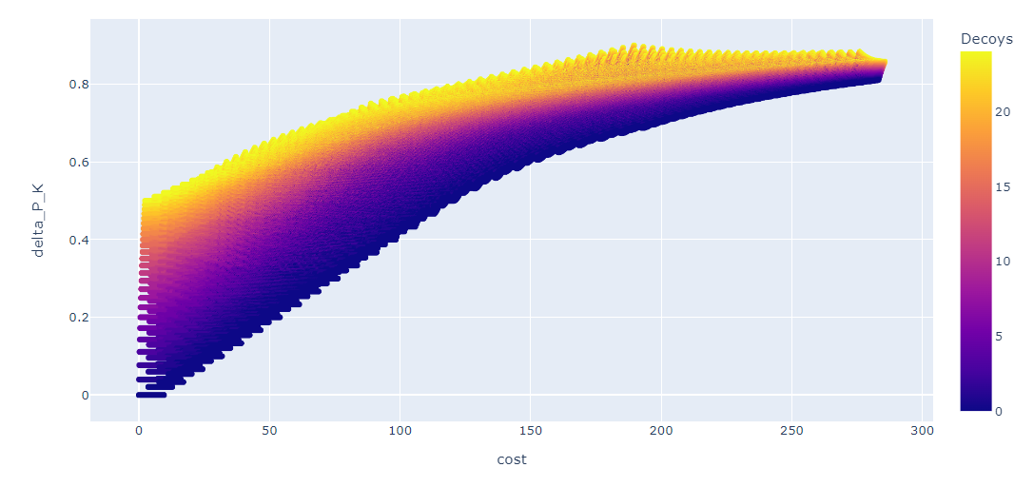

Cost/Value of Decoys vs. Shells
Measure of Value is Δ$P_{K}$
High-Decoy Solutions dominate the Pareto Frontier

Slide 10
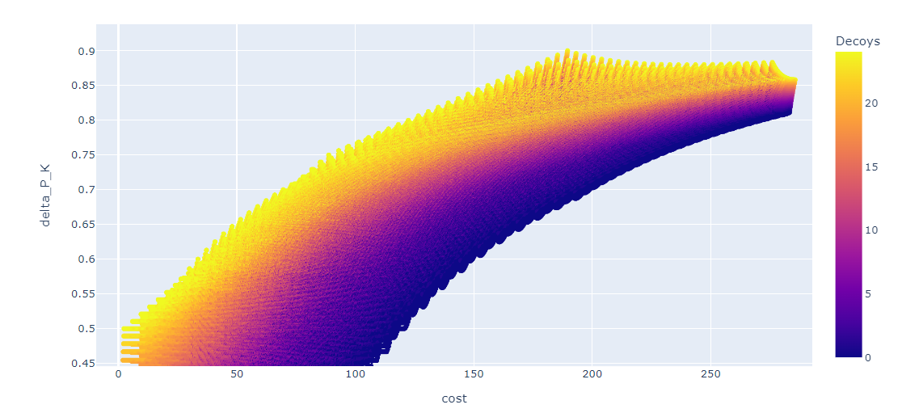
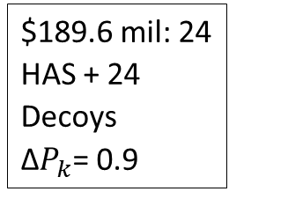
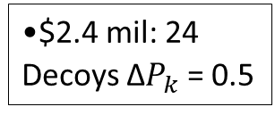
Cost/Value of Decoys vs. Shells
$2.4 mil: 24 Decoys Δ$P_{k}$ = 0.5
$189.6 mil: 24 HAS + 24 Decoys Δ$P_{k}$= 0.9

Slide 11
Towards a Universal Model of Decoy Value

Slide 12
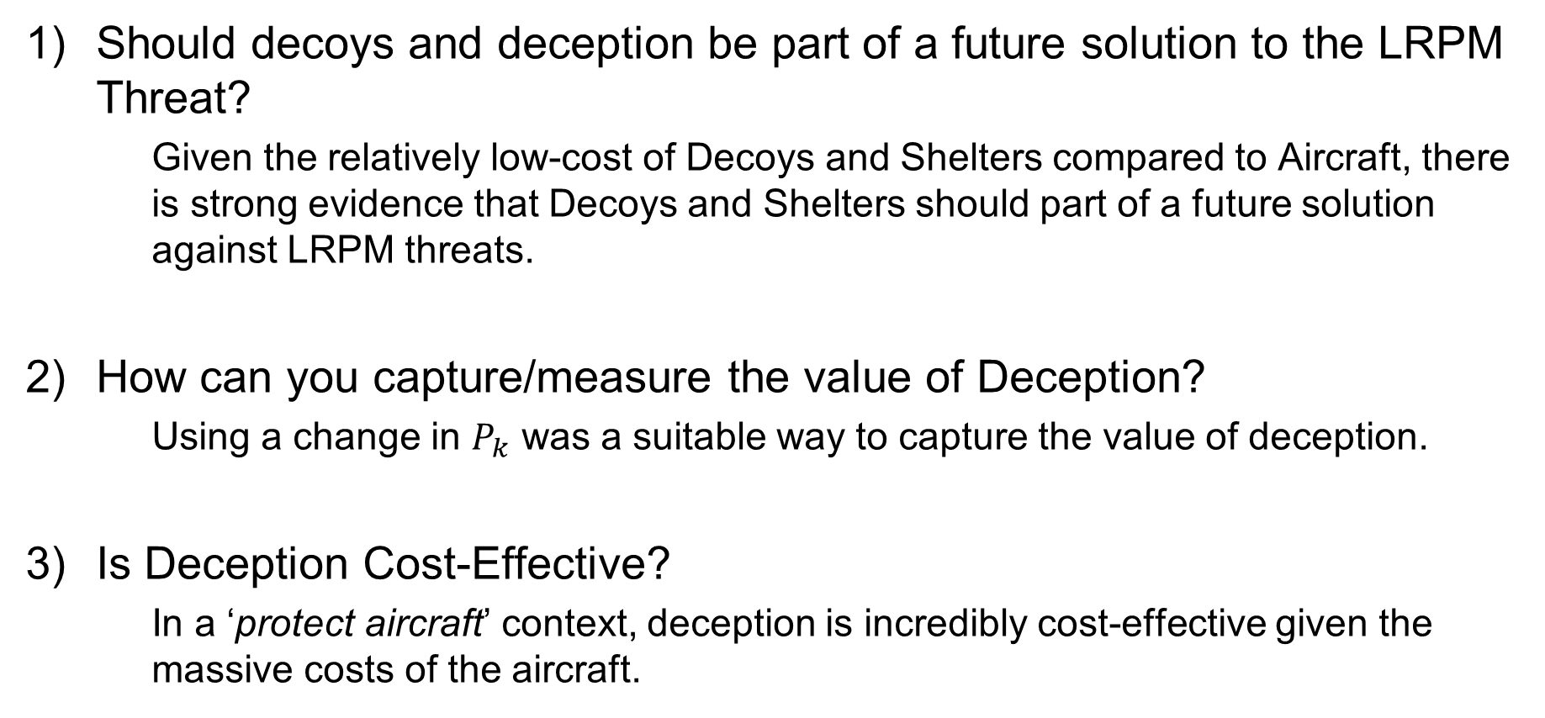
Research Answers and Contributions
Should decoys and deception be part of a future solution to the LRPM Threat?
Given the relatively low-cost of Decoys and Shelters compared to Aircraft, there is strong evidence that Decoys and Shelters should part of a future solution against LRPM threats.
How can you capture/measure the value of Deception?
Using a change in $P_{k}$ was a suitable way to capture the value of deception.
Is Deception Cost-Effective?
In a ‘protect aircraft’ context, deception is incredibly cost-effective given the massive costs of the aircraft.

Slide 13
Limitations
All models presented are based upon perfect decoys such that the enemy can only randomly guess which targets are real or not.
Costs of Decoys don’t take into account any personnel or activity that would be required to operationalize the deception.

